Slide 1
PROJECT TITLE :-A cross-platform mobile application to display the important features of Yamaha bikes
PIP2001 Capstone Project
Review-0
Batch Number: 218
Under the Supervision of,
Prof. Himanshu Sekhar Rout ,Professor
School of Computer Science and Engineering
Presidency University
Roll Number | Student Name
20211CST0036 | Deepika B R
20211CST0069 | Suchitha R
20201CST0088 | Ugama S
20211CST0134 | Nissi Shalom S
Name of the Program: Computer Science and Technology
Name of the HoD: Dr. Saira Banu
Name of the Program Project Coordinator:
Name of the School Project Coordinators: Dr. Sampath A K / Dr. Abdul Khadar A / Mr. Md Ziaur Rahman

Slide 2
Content
Problem Statement
Analysis of Problem Statement
Timeline of the Project
References

Slide 3
Problem Statement Number:
Organization: Yamaha Motor Pvt Ltd.
Category (Hardware / Software / Both) : Software
Problem Description:
The input to our cross-platform mobile app is user interaction for exploring Yamaha bikes.
- Bike details and specifications are fetched, parsed, and displayed in an easy-to-understand format.
- Multiple bike models are compared using simplified, interactive visualizations.
- 3D/AR models of the bikes are generated using deep learning, allowing users to explore models interactively.
- Nearby Yamaha dealerships are located via integrated geolocation services.
Difficulty Level: Medium

Slide 4
Analysis of Problem Statement
Technology Stack Components:
Bike Data Retrieval:
Tech: Yamaha API or Custom Backend (Node.js)
Feature Extraction & Comparison:
Tech: Python (Pandas, NumPy)
Geolocation Services:
Tech: Google Maps API
Backend Infrastructure:
Tech: Firebase
Integration & API Development:
Tech: Node.js
App Development:
Tech: React Native or Flutter
Software / Hardware Components:
Python and its frameworks
React for application development
Google Firebase for Database
Node.js for server handelling
Google Maps API

Slide 5
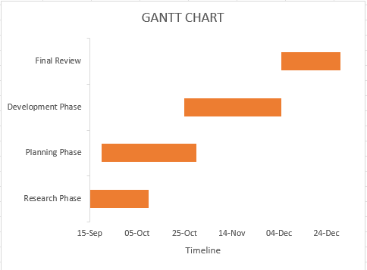
Timeline of the Project (Gantt Chart)

Slide 6
References (IEEE Paper format)
Book: Felgo, Simon Reimler, Andreas Fertig, Matthew Knippen, David Katz, Chris Griffith, Maximiliano Firtman, Paul Hudson Submitted on: 25 May 2020
Magazine: Mastering Cross-Platform Development: Flutter, React Native, and Xamarin
Website: https://www.oreilly.com/library/view/cross-platform-development/

Slide 7
References (IEEE Paper format)
Book: Frank Wang, Michael Tsang, Marta Gonzalez, Vikram Srinivasan, Lars Erik Holmquist, Tapan Parikh, Anthony LaMarca Submitted on: 15 July 2019
Magazine: Simple Location-based Application Development for Mobile Phones
Website: https://ieeexplore.ieee.org/document/4375927

Slide 8
References (IEEE Paper format)
M. Latif, Y. Lakhrissi, E. H. Nfaoui and N. Es-Sbai, "Cross platform approach for mobile application development: A survey," 2016 International Conference on Information Technology for Organizations Development (IT4OD), Fez, Morocco, 2016, pp. 1-5, doi: 10.1109/IT4OD.2016.7479278.
GITHUB : https://github.com/Ugama30/Capestone-Project.git

Slide 9


